Slide 1





SPRING & SPRING BOOT
LECTURE - 4

Slide 2

Today’s Agenda
How Spring Helps In DI ?
Introduction To IOC & IOC Container
Types Of IOC Containers
Working Of Spring Container

Slide 3
How Spring Helps In DI ?
In all the previous examples we discussed , we ourself implemented DI through code.
However the Spring Framework also can perform DI for us automatically and that’s probably the FIRST REASON for us to use Spring for our projects.

Slide 4
Important Question
Question ?
Why would we want Spring to create objects and manage dependencies for us if we can do it ourself using new keyword ?

Slide 5
Important Question
Answer
There’s nothing wrong with we ourself creating the object, but wouldn’t it be nice to manage the dependencies in a better way?
Imagine an application with dozens or even hundreds of classes.
Managing such a large number of objects will be extremely difficult. This is where Spring comes to the rescue.
Instead of constructing dependencies by itself, an object can retrieve its dependencies from Spring .
All we need to do is to provide the container with appropriate configuration.

Slide 6
How Spring Performs DI ?
Spring performs DI using a special software component called IOC Container.
But before discussing about IOC Container lets recall what is IOC ?

Slide 7
What Is IOC ?
IOC stands for Inversion Of Control.
It is a principle in software engineering which transfers the control of objects or sections of a program to a container or framework.
Lets take two examples to understand this.

Slide 8

Example 1
Suppose you are a student.
So what should be your main task ?
Definitely learning/studying . Right ?
Now , imagine you want to learn Spring Framework.

Slide 9
Example 1
Can you can start learning Spring by yourself ?
Yes, why not !
But before learning Spring you will require resources like books , notes, videos, assignments and most importantly doubt solving.
Now if you have to arrange these resources yourself then it will be very difficult for you to focus on your core task i.e. learning Spring.

Slide 10
Example 1
But suppose you join Spring Course at an institute .
Now it will be institute’s responsibility to provide you someone who will teach you Spring , provide you notes , solve all your doubts , provide assignments and their solutions.
And you are asked just to learn Spring , then it will be very easy.

Slide 11

Example 2
Suppose you are a painter artist .
So what should be your main task or expertise ?
Definitely painting . Right ?

Slide 12
Example 2
But before painting you will require tools like canvas , board, brush, colour palette etc.
Now if you have to arrange these tools yourself then it will be very difficult for you to focus on your core job i.e. painting.
But if someone arranges these tools for you and you are asked just to do the painting then it will be very easy.

Slide 13
What Is IOC ?
That SOMEONE is the FRAMEWORK and this principle is called as INVERSION OF CONTROL.
And to implement IOC and provide us Dependency Injection support , the Spring Framework uses IOC Container.

Slide 14
Top Frameworks Using IOC
Spring
ASP.Net
RoR
Angular
Laravel
Google Guice

Slide 15
The Spring IOC Container
The Spring IoC container or Spring Container is the "Heart" or "Core Component" of the Spring Framework.
It is same like :-
JVM which is used to execute the Core Java programs.
Servlet Container which is used to execute the Servlets.

Slide 16
Responsibilities Of Spring Container
The Spring Container has many responsibilities but most important of them are:
Instantiate the Spring bean objects
Configures the Spring bean objects
Initialize the Spring bean objects
Manage the Spring bean life-cycle
Destroy the Spring bean objects
Dependency Injection
Resource Management ( db conn, api integration, security integration)

Slide 17
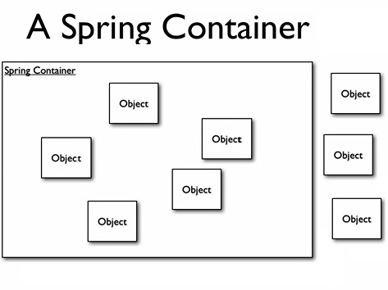
What Is A Spring Bean ?
In Spring, any Java object that is created and managed by the Spring container is called as a Spring Bean.

Slide 18
Types Of Spring Containers
There are basically two types of IOC Containers in Spring:
BeanFactory: It is an interface available in the package org.springframework.beans.factory but is the old or outdated container.
ApplicationContext: It is also an interface and it inherits from the BeanFactory interface. It is available in the package org.springframework.context and is the new and modern container.

Slide 19
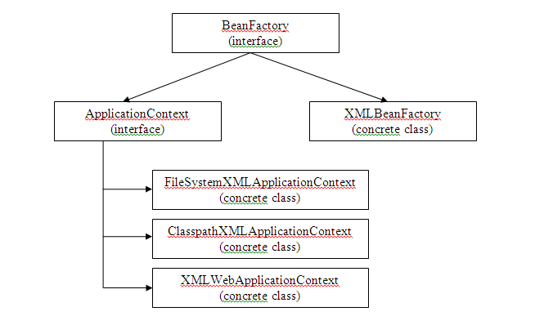
Hierarchy Of Spring Containers

Slide 20
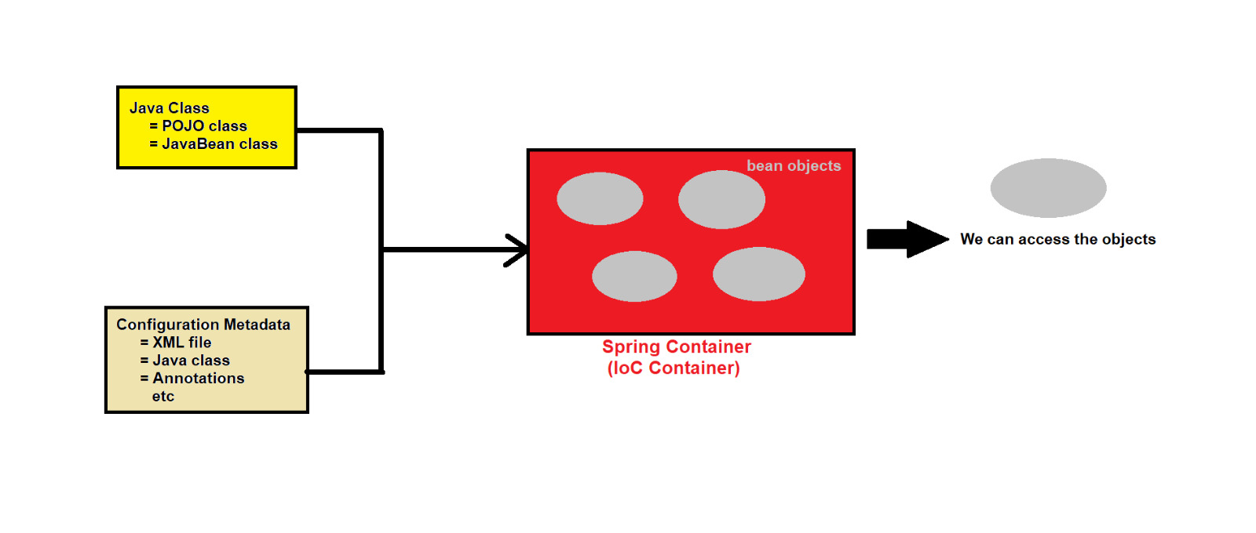
Working Of Spring Container

Slide 21
What Is Configuration ?
Configuration means settings/instructions provided to the Spring container .
They help the container to define and manage various aspects of an application.
There are lot of configurations in Spring like:
Bean definitions
Dependency Injection
Bean Lifecycle
Bean Autowiring
Bean Post Processing
Database Configurations
Security Confgurations
AOP Configurations

Slide 22
Ways Of Providing Configurations
Configurations can be provided to Spring by :
XML
Java
Annotation
Properties file
Environment Variables
Command line arguments
and many more other ways.

